Slide 1


TransparentChoice
Score Projects – Best Practice Guide
Best Practice
Client Hub Page

Slide 2
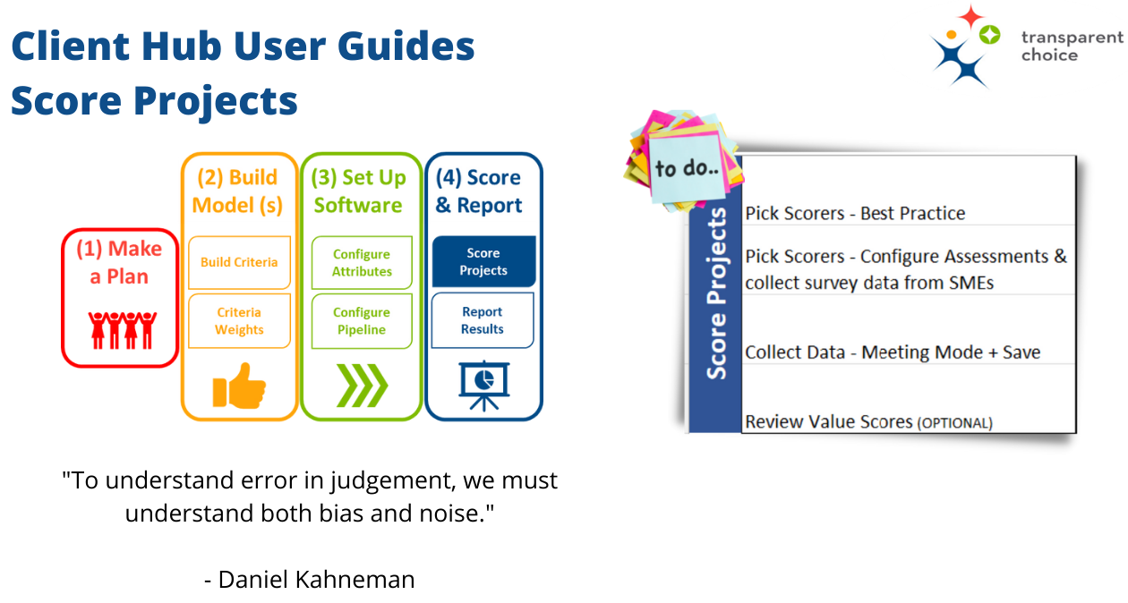

Slide 3
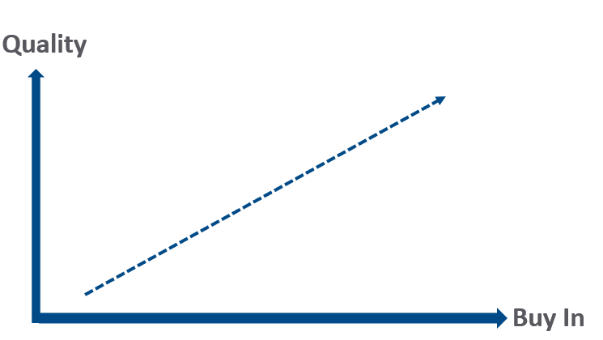
Pick Scores
Make Scoring a Team Sport for better data
Quality
  Increasing the breadth of data collection will reduce bias & the effect of subjectivity
Buy In
  Involving stakeholders in scoring builds trust in the decision & the process
Notes:
Demo

Slide 4

Pick Scorers
Unlock the value of the Wisdom of the (small) Crowd
At a livestock fair in 1906, scientist Francis Galton observed visitors taking part in a contest to guess an ox’s weight in pounds. The results were surprising: although no individual, including cattle experts, could guess the ox’s exact weight, the mean value of all the visitors’ estimations was a mere pound more than the animal’s actual weight
Source: Derived from Wisdom of Crowds by James Surowiecki
Notes:
stuart

Slide 5
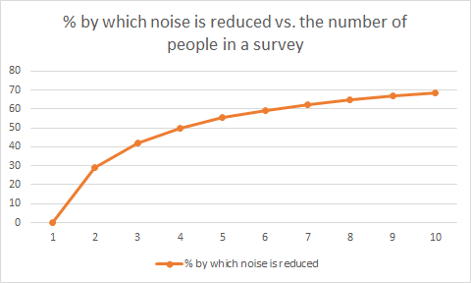
Pick Scorers
4-5 scorers per question is ideal
“Wherever there is human judgement there is noise… And more of it than you think”
― Daniel Kahneman
>3 points of view halves the noise in the data
>5 people sees benefits diminish for the effort

Slide 6
Pick Scorers
4 key causes of poor quality data
Unconscious bias
Respondents simply don’t understand something. Use focused discussion to align – for example with technical and commercial colleagues building greater empathy for each others’ perspectives.
Conscious bias
Respondents are trying to ‘game’ the system with a high score for ‘their’ projects. Use the group discussion format to spot these outliers and challenge on the rationale behind the rating.
Subjectivity
Scores are generally not absolute ‘facts’ but are judgement calls based on the perspective of the respondents. Through surveying more than one person the quality of the decision will become inherently stronger
Anchoring
Groups have been proven to be overly influenced by the first person to speak. By capturing views before meeting everyone gets an equal voice.
“Wherever there is human judgement there is noise… And more of it than you think”
― Daniel Kahneman

Slide 7
Pick Scorers
Align Criteria to Subject Matter Expertise
Get experts involved to maximise value of subject matter knowledge
Use scoring to explore different groups’ point of view
Mix qualitative survey data & quantitative modelled data sources
Consider a model with 4 criteria
Who is best placed to score projects?
ROI
Direct data feed from finance model
Strategic Alignment
Strategy team
Brand Alignment
Marketing team
Feasibility
Engineering team
Notes:
Demo

Slide 8
Pick Scorers
Align project scoring to stakeholders
Consider a global organisation with a mix of country teams & specialist central teams – getting the right subject matter expertise is a more complex challenge (but easy to do in the software…)
Project | Sales | Operations | Marketing | Country A | Country B | Country C | Hardware Engineer | Software Engineer | Data Engineer
New sales software functionality | x |  |  | X | X | X |  | x
Fix operations hardware country C |  | x |  |  |  | x | x
Enhance sales & marketing data | x |  | x |  |  |  |  |  | x
Global Operations platform |  | x |  | x | x | x | x | x
Complex modern organisations may require a bespoke targeting approach – getting votes from people whose opinion is not that relevant creates noise and wastes time

Slide 9
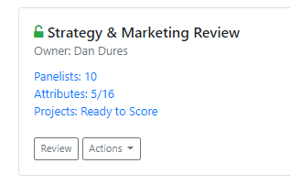
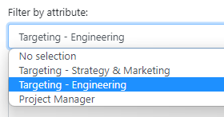
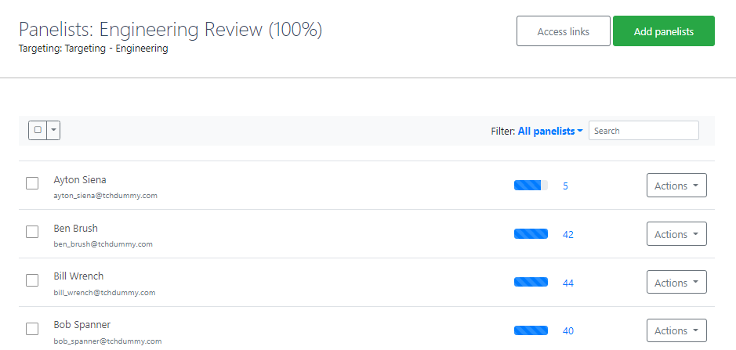
Pick Scorers
Assign Surveys to Respondents
Before you start update People section
  See Criteria Weights training for details
  Add extra People if they were not in Criteria Weights already
Set up Assessment Panels: different approaches
  All-In One – i.e. everyone scores everything
  By Attributes – e.g. engineers vs. marketeers
  By Alternative – e.g. by department
Adding Panelists
  Manually pick People for each assessment panel (option 1)
  Add Targeting Cell using an email Attribute (option 2) to auto-populate
Get started – share email links with unique URL for each Respondent
  Note that this URL will update automatically as targeting or Lists are changed

Slide 10
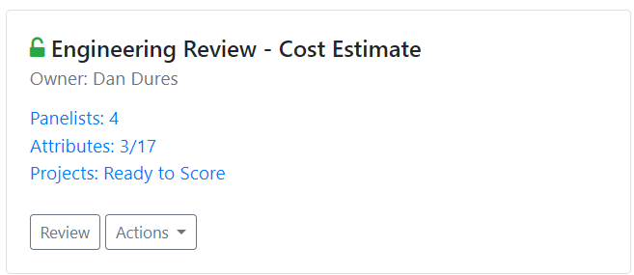
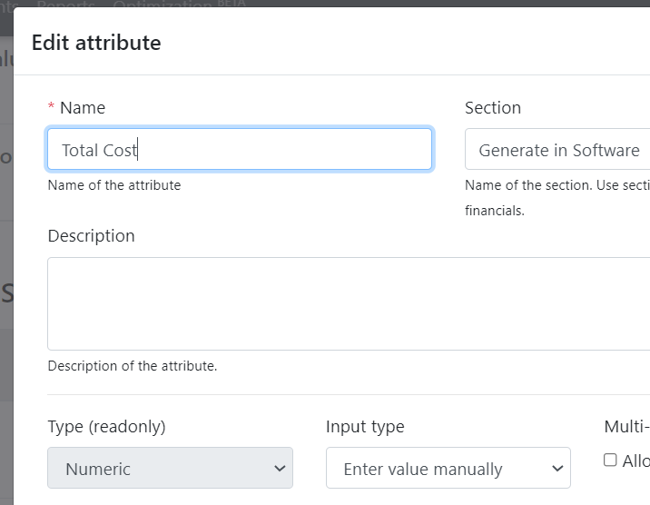
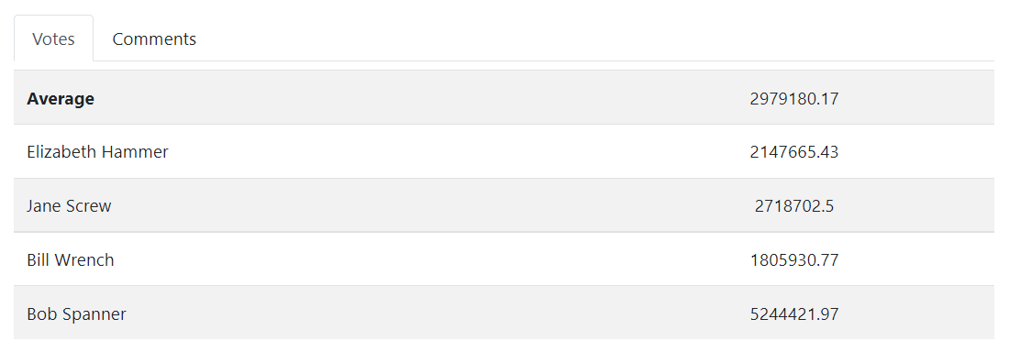

Pick Scorers
Better Estimations as a Team
Assessment Panels can also be used for generating any data point
Key variables such as cost can still suffer from the same perception bias as criteria scores…
…so why not approach it as a team!
Bob, can you explain why you think this project will cost this much?

Slide 11





Pick Scorers
Best Practice Tips
  Align to subject matter knowledge to get best quality answers
  4-5 Respondents per question is ideal for subjective debate…
  … single respondent answers should only be for ‘hard data’
  Spread the workload where possible so individuals aren’t overloaded
  Consider using a group review to estimate resource requirements

Slide 12
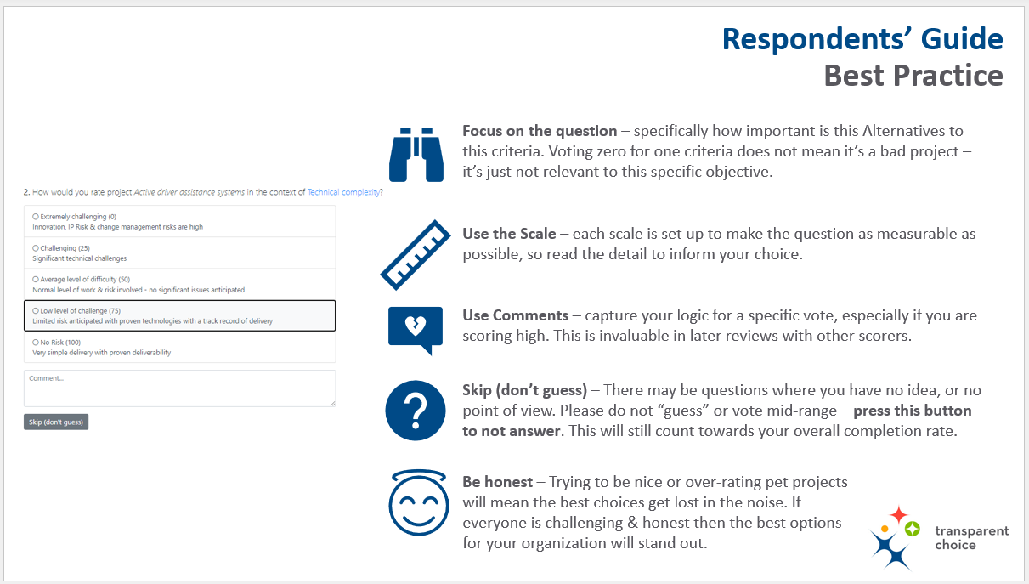
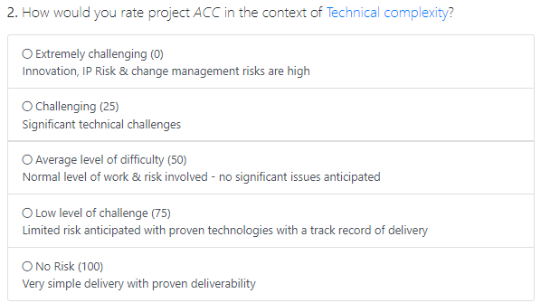


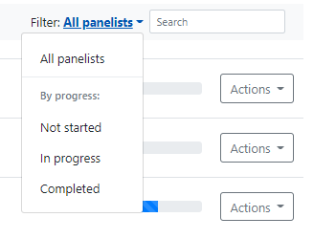
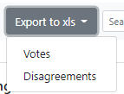
Collect Data
Chase Compliance to improve data quality
Enable Best Practice
(from Respondents’ guide)
  Focus on the Question – add good descriptions for both Criteria & Alternatives
  Use Scales – minimise ambiguity with clear descriptions
  Encourage Comments – to add insight to numbers
  Skip / Don’t Guess – use button to ignore questions if you don’t know
  Be Honest – foster a culture of honest appraisal in scoring
Use the software to drive compliance ahead of meeting
  Track Completion Rate
  Send out Reminder Emails using completion level filter
Download Votes to deep dive data

Slide 13
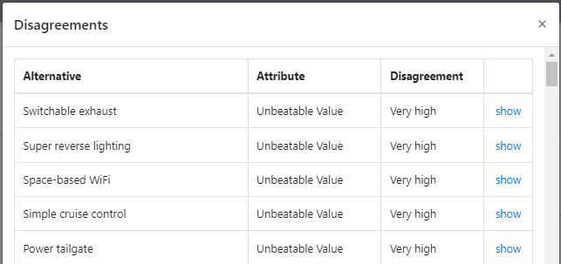
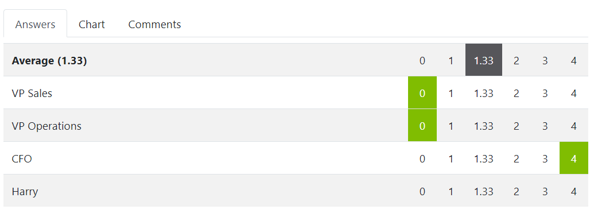
Collect Data
Review Results, especially Disagreements
Disagreement levels are calculated by the software
  Algorithm looks at distribution of votes to produce classification
  Simple 6 point scale from very low to very high
Focus on disagreements to explore causes, which may be…
  Misunderstanding
  Game Playing
  Bias / Blind-Spots
  Legitimate preferences
Decide how you want to solve disagreements
  Apply an average score
  Agree score together
  Senior arbiter decides
Download Disagreements data for deep dive analysis
The software will show you where you have issues to discuss
Diving into voter level results helps structure debate

Slide 14

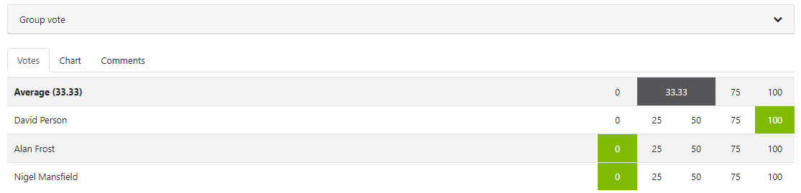

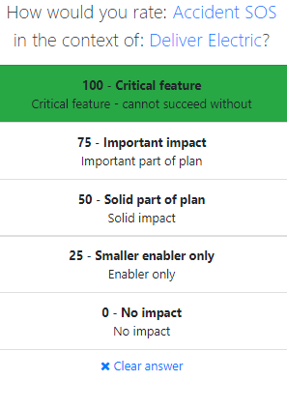
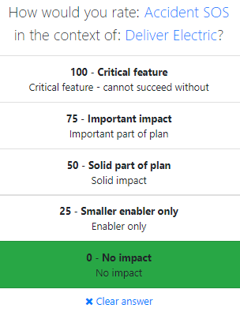


Collect Data
Review Results using Meeting Mode
Meeting to review results has significant value
  Use Meeting Mode to create live link from surveys to facilitator view
  Use Disagreement to find areas to discuss as priority
  Use “Reveal” functions to share / hide others’ voting data
Meeting format is flexible
  Virtual, with everyone logged on separately
  Or use mobile connection while you sit together in a room
Download Disagreements Report for deep dive analysis
David can you explain your vote….
Not sure I can… I’ll change my vote now!

Slide 15
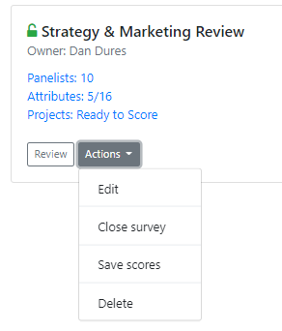
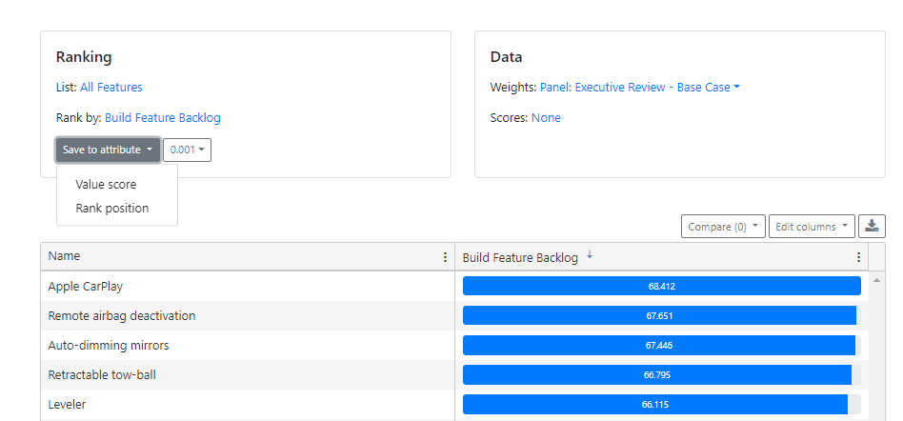
Collect Data
Publish Results to complete AHP model
Save scores to publish results of voting to Database
  Scores are now saved as Attributes into the database
  Update anytime by re-saving
Go to Ranking to connect scores to criteria weights
  Pick Weight Set to apply
  Use “List” to chose which projects are fully scored
  Select Value Score to write results to Database
  See below for more tips
Value Score is a normalized 0-100 score that combines scores across all criteria into 1 number
  See below for details
Save scores when you’re happy that the data collection process is complete
TIP – if you’ve split Attributes in your model into different panels don’t forget to save them all before proceeding
Create a new Attribute for Value Score – this is the result of your AHP model

Slide 16
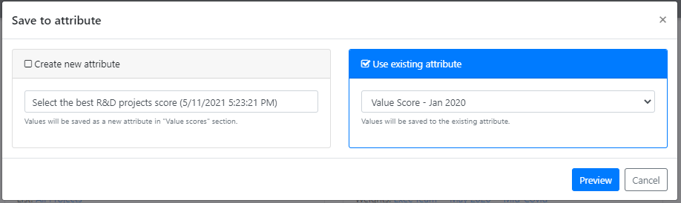
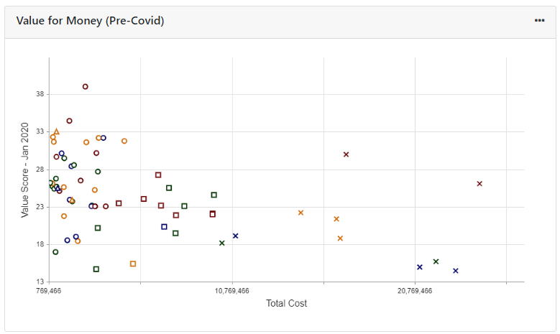
Collect Data
Publish Results: Tips
Use Lists to make sure you don’t overwrite projects by accident!
Overwrite an existing Value Score or create a new one
Save as Normalized Score or Rank, or both
New Value Score will now available in Reports to produce charts & in Grid View
Drill into Rank By to save at lower level within the model (e.g. publish each criteria as its own mini-model)
Toggle Weights to create alterative scenarios with different prioritisation objectives
Ignore Scores – it’s our legacy solution for collecting data
Value Score is our term: you can name this metric anything you like

Slide 17
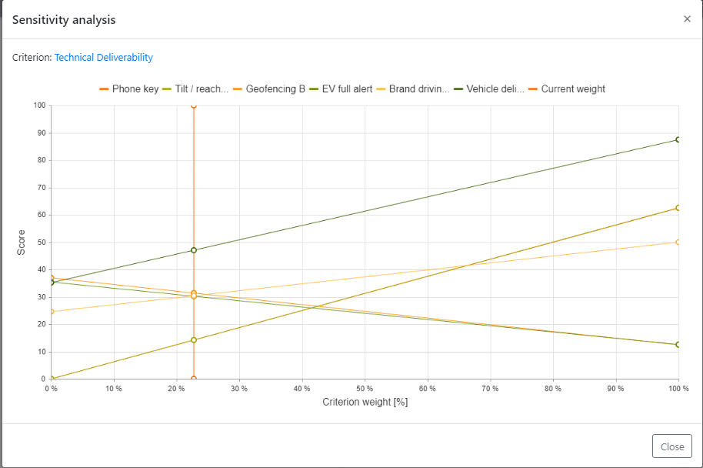
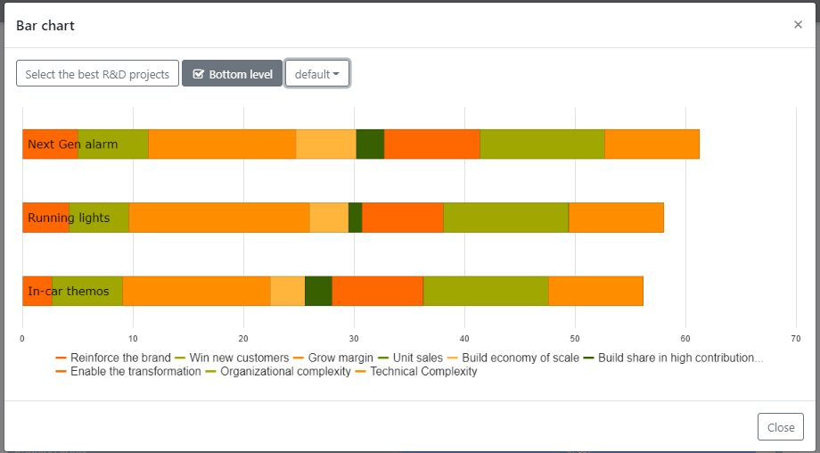
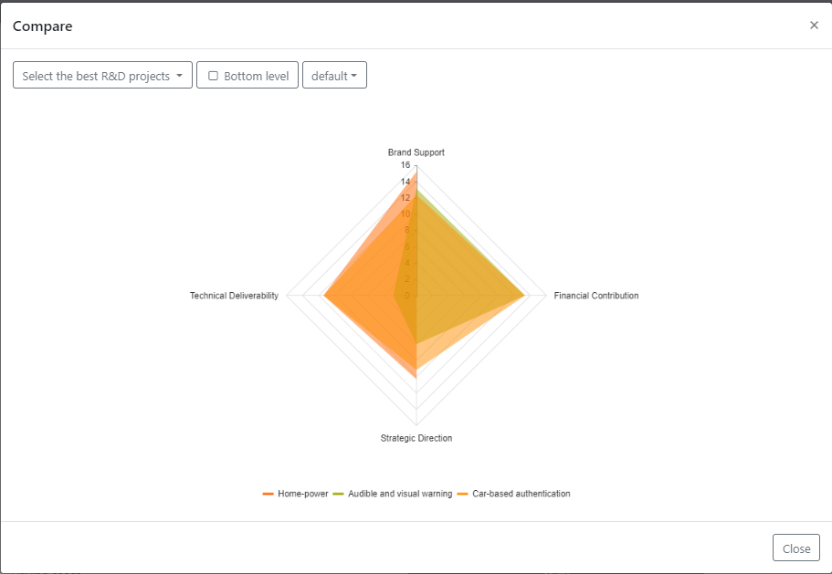
Review Value Score
Explore your model results
Within the product we can see this breakdown in scores
Deep dive into Alternatives you want to compare: which criteria are they strong / weak on?
Use Sensitivity Analysis to see what happens to score if the weight of a given criteria increases
Use this detailed view of the data to support decision making + validate scoring
Download data for off-line analysis
TIP
These charts are found by using the COMPARE function in RANKING page, by highlighting & holding CNTL

Slide 18
Review Value Score
Normalizing data: Scale Based
Value score is created by Normalizing a value & applying criteria weight
WHERE
Normalized Score = Survey Score / Highest Value in Scale
THEN
Normalized Score will then be multiplied by criteria weight to produce Value Score in an AHP model
Criteria A | Survey Score (scale of 0 - 4) | Normalized Score (fed into AHP model) | Criteria A Weight (from weight set) | Value Score (for Criteria A)
Project 1 | 3 | 75 | 15% | 11.3
Project 2 | 1 | 25 | 15% | 3.8
Project 3 | 0 | 0 | 15% | 0
EXAMPLE
Note: this applies to Scale based data collection only. See below for non-scale based Normalization methodology

Slide 19
Review Value Score
Normalizing data: Non-Scale Based
Normalized data means raw input is converted into a ratio from 0-100
For Manual Attributes* we use the Ideal Mode of Normalization:
* See Data Training for details on Attribute types
Normalized Value = Raw Value / Maximum Value
Where Maximum Value = Max Value from Attribute definition OR Max value from the other Alternatives in the model
WHERE
To have a ‘stable’ outcome that cannot change each time you add a new Alterative (with a score higher than any previously seen) you must set a MAX value in Attribute
THEN
Criteria A MAX = 50 | Score from Attribute (Manual Entry) | Normalized Score (fed into AHP model) | Criteria A Weight (from weight set) | Value Score (for Criteria A)
Project 1 | 10 | 20 | 15% | 3
Project 2 | 50 | 100 | 15% | 15
Project 3 | 0 | 0 | 15% | 0
EXAMPLE

Slide 20
Review Value Score
Aggregate Normalized Scores to create Total Value Score
We have 4 sub-criteria & 3 projects in our model which have been weighted & scored as follows…
Criteria
C1.1 = 20%
C1.2 = 40%
C2.1 = 10%
C2.2 = 30%
project 1
50
100
0
50
project 2
0
0
100
100
project 3
100
100
100
100
65
40
100
Project 1 strong for Criteria 1.2 which is most important criteria – hence a high score
Project 2 is relevant to less important criteria, and therefore only scores 40
Project 3 is 100 for all criteria – and therefore scores a perfect 100

Slide 21
TransparentChoice
Score Projects – User Guide
Software Set-Up
Client Hub Page

Slide 23
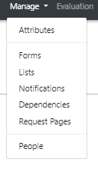
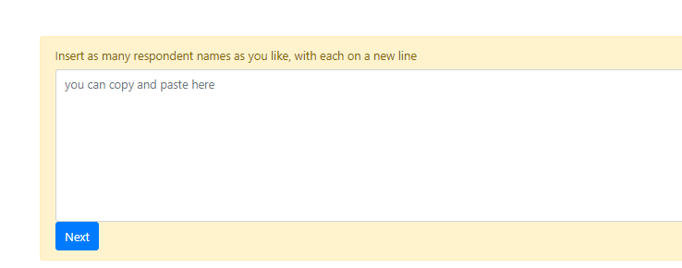

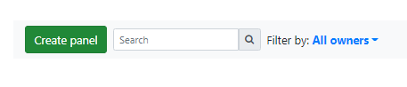
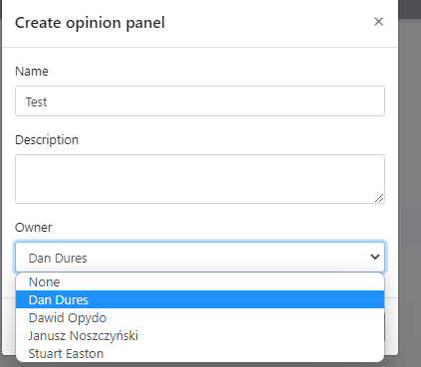
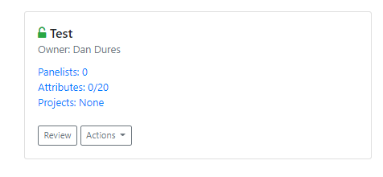
Pick Scorers
Assessments Set Up
1
Add People
Name + Emails for everyone involved in scoring projects – see criteria weights training for details
2
Create Panel
Name Panel & add notes for reference. Assign an owner from any workspace user.
3
Configure Panel
You’re now ready to set up the panel - see below

Slide 24
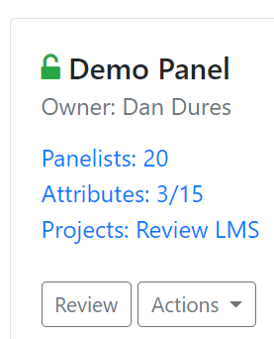
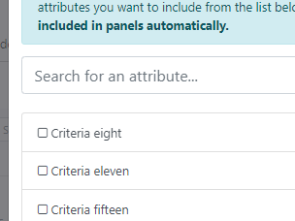
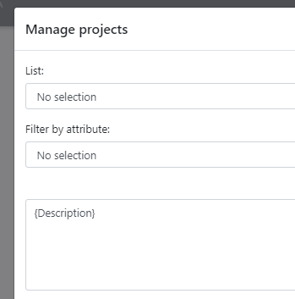
Pick Scorers
Assessments Configuration
Click to pick which People take the survey
(NOTE: for targeting this will auto-populate)
3
2
Pick any numeric Attribute to score
Pick Projects by Selecting a List
1
Add targeting cell to lock survey (optional)
Enrich description to the project to help scorers

Slide 25
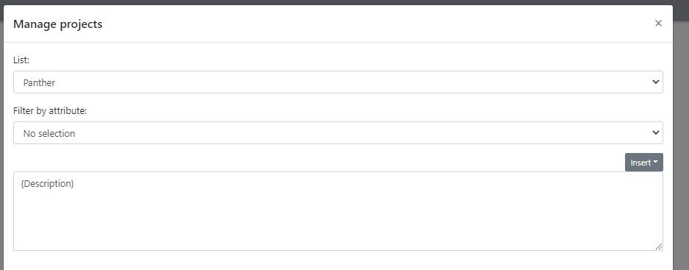
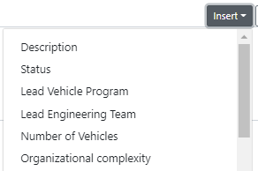
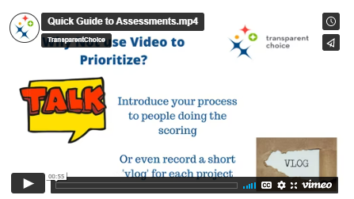


Pick Scorers
Enrich Description
Use Insert to pick an Attribute from a List
Type into the box for generic text that will appear in every Alternative Description. Leave {Description} to keep the core attribute field (recommended).
Add Alternative specific data by inserting an Attribute by using {ATTRIBUTE NAME}
Format with basic HTML
BOLD <b> {Resources - total} </b>
Italic <i> {Resources - total} </i>
Highlight <mark> {Resources - total} </mark>
Hyperlink <a> {link attribute} </a>
Or even embed a video with a link

Slide 26
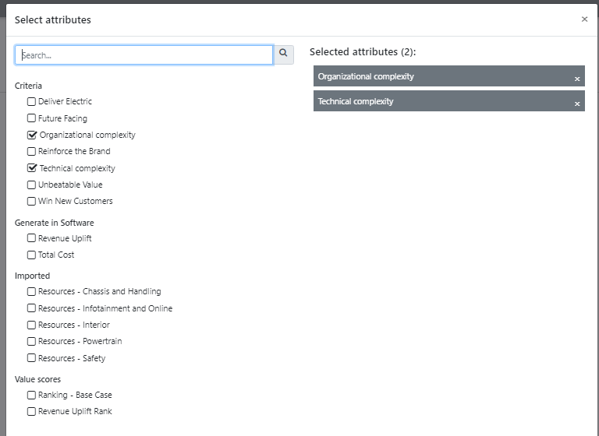
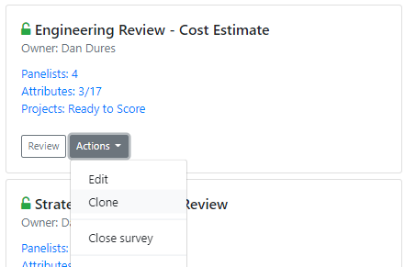
Pick Scorers
Add Criteria
Links Sub-Criteria to Scoring - although any numeric attribute can be scored via Assessments
Ensure all your criteria are measured to complete the scoring in your model
TIP – Clone function can help if you’re splitting by project

Slide 27
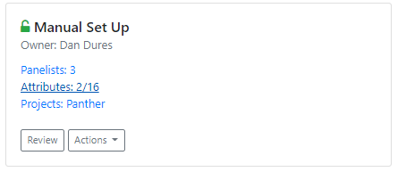
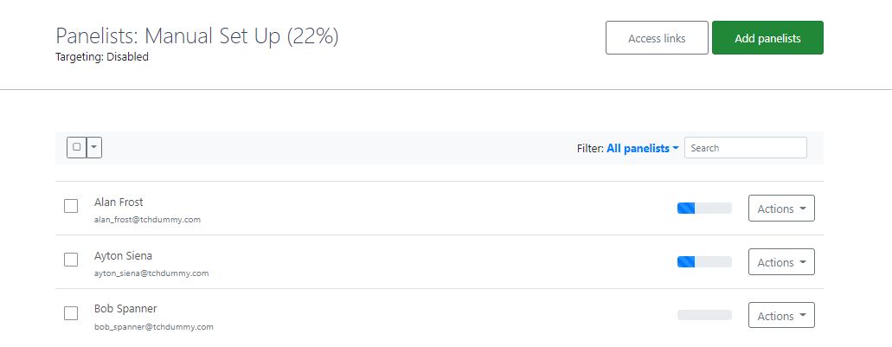
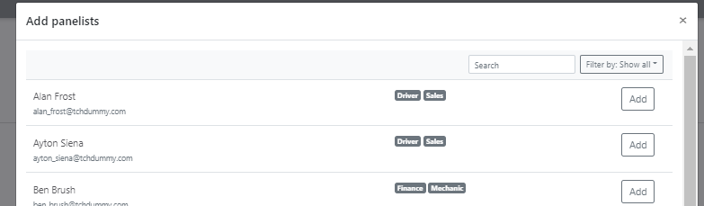
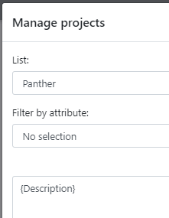
Pick Scorers
Add Panelists - No Targeting
Hit Add Panelists – to pick from People to add to survey
Leave Targeting Attribute Blank – now all questions will go to all Panelists
Click Add to pick People
Use Filter to apply Tags

Slide 28
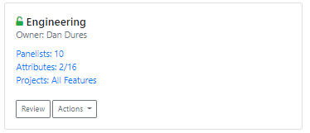
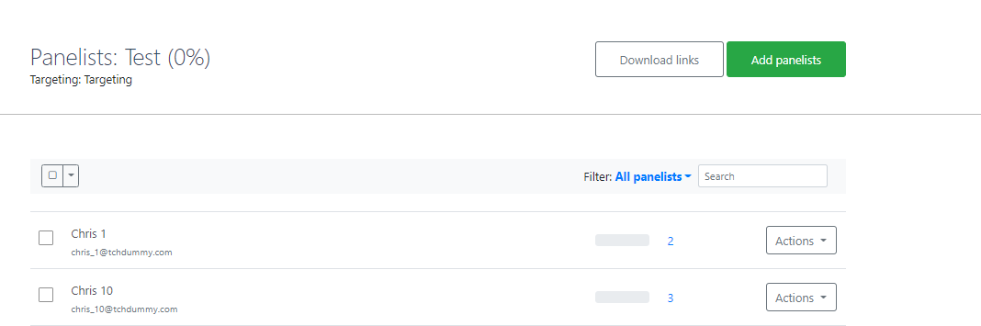
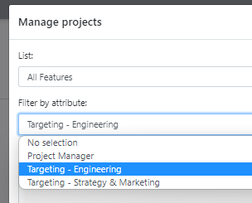
Pick Scorers
Add Panelists – Using Targeting
Once you have projects to score your Panelists list will populate automatically, with the number of projects listed by each Respondent
Select Email Attribute – This will pick the People to score your projects
(see below on how to set this up)

Slide 29
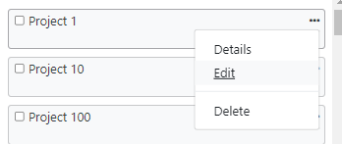
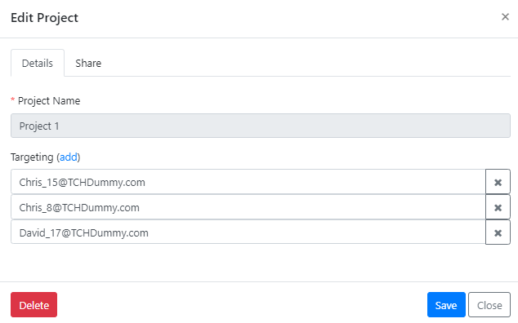
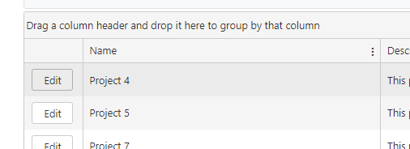
Pick Scorers
Setting up targeting – 3 options
Name | Targeting
Project 1 | Chris_15@TCHDummy.com,Chris_8@TCHDummy.com,David_17@TCHDummy.com
Project 2 | David_14@TCHDummy.com,Jodie_18@TCHDummy.com,Matt_17@TCHDummy.com
Project 3 | Peter_6@TCHDummy.com,Matt_17@TCHDummy.com,David_16@TCHDummy.com
Project 4 | Peter_16@TCHDummy.com,Chris_12@TCHDummy.com,Chris_6@TCHDummy.com
Project 5 | Jodie_2@TCHDummy.com,David_12@TCHDummy.com,Chris_14@TCHDummy.com
Import Targeting Cell
Use excel to create comma delineated string of email addresses
1
Edit from Kanban
Use a Form then add or remove voters project by project
2
Edit via Reports
Use a Form then add or remove voters project by project
3

Slide 30
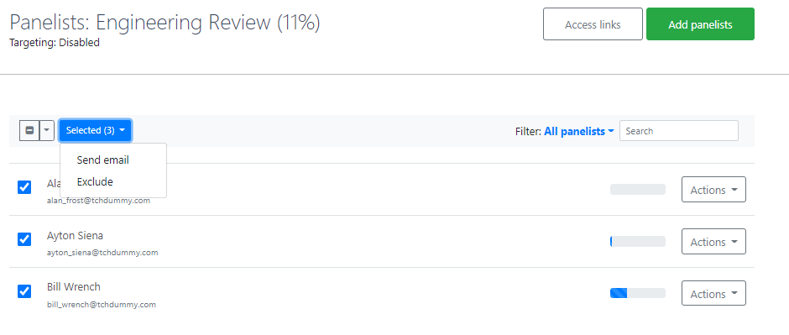
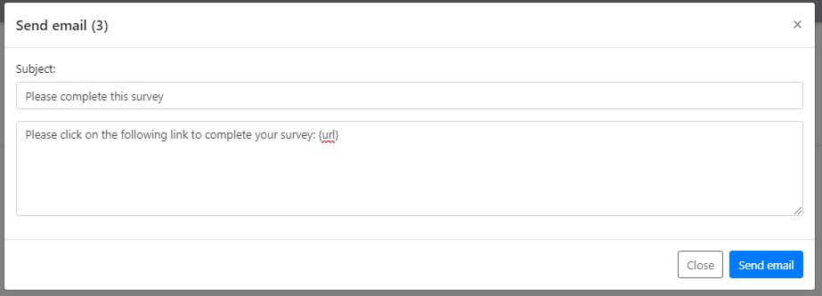
Pick Scorers
Send out batch Email with survey links
Click Multi-Select Box to highlight all Respondents
Click Send Email
Customise the Email content - {URL} will insert a personalised link to their survey
1
2
3

Slide 31



Pick Scorers
Other ways to connect to surveys
Click Access Links to get direct access to URLs
  Click clipboard to copy one link
  Download links to drop all into Excel
Click Actions nest to your chosen Respondent
  Click Email to generate an email for just them
  Click Review to get direct access into their survey
1
2

Slide 32


Pick Scorers
Chase Panelists
1
Check Completion Rate
Use Filters to Select Respondents who have not completed
Select them… and send a reminder email with their URL included
3
2

Slide 33



Collect Data- Respondents’ Guide to Assessments
This simple guide is available to all Respondents via the software, to step them through how to complete the survey. Please click here to review

Slide 34



Collect Data
Start Meeting Mode Meeting Mode
1
Start Meeting – Opens up the meeting to anyone with a Link (see below for settings)
2
Open Survey – Enables Respondents to edit their survey: recommended to keep closed during meeting
3
Access Links – Re-send links to All or specific Respondents: (see above for details)
4
Analyze Votes – After completing all questions you should focus into areas of disagreement (see below)
1
2
3
4

Slide 35

Collect Data
Meeting Mode Settings
Auto-Reveal – Will enable you to reduce bias by ‘hiding’ others’ votes while people review the question – the facilitator can then reveal votes once initial opinions are captured
Anonymous Mode – Hides the names of the voters in Respondents’ screens so that people don’t follow others’ votes
TIP – Decide on how you want to run the session before you begin the meeting & set up accordingly
You’re now ready to start the meeting! Respondents will now follow your screen (via their Links) once they hit Join Meeting button

Slide 36



Collect Data
Meeting Mode - Running a Meeting
1
2
1
Settings – Same options as meeting set up
NB Analyze Votes guide is below
3
Scoring question – Click on the Alternative or Criteria for a Description
TIP – You can use the Custom 1 Pager Description for Alternatives, configurable via Assessment Panels
4
2
5
3
Open / Close Voting Panel – We recommend to hide the panel & not use the Facilitator Override
6
Facilitator Override – Making a vote here will override Respondents’ votes
TIP - we recommend not to use this as standard
4
5
Revert to Average– Reset model to use Respondents’ score (rather than Facilitator Override)
7
6
Comment – Capture key points from the discussion (NB individual Respondents can also post comments)
7
Votes – See Respondents’ votes & comments in real time
TIP - don’t refresh to sync, it’ll kick you back to Q1

Slide 37


Collect Data
Meeting Mode – Navigation
Question Status Tracker – shows you where the data for your model is currently coming from
TIP this is very important – make sure all your questions are green
Data from Votes – Respondents’ answers are being combined by an average (geometric mean) to create the model output
Data Override – Score is coming from the Facilitator: this can be a legitimate approach but don’t do it by accident!
No Data – Question has no replies & no override
Navigation – Key choice is to order the questions by Criteria OR by Alternative – toggle by clicking on the question panel
TIP: Organise your review based on complexity: If you have simple criteria but complicated Alternatives… order by Alternative… if your Alternatives are simple but criteria are more complicated then order by criteria

Slide 38



Collect Data
Meeting Mode - Disagreements
Disagreements – shows where Respondents’ votes are least aligned based on distribution of scores
Click show to review answers & explore topic
TIP – Many clients ask Respondents to complete the survey before the meeting and go straight into Disagreements

Slide 39

Collect Data
Download Data to Excel
VOTES – Detailed Voting Data for all Panels
* Report on compliance across multiple panels with a single click
* Support Governance with a record of individuals’ votes + comments
* Create data tables for in-depth analysis
DISAGREEMENTS – Detailed Disagreement data for all Panels
* Replicates Disagreements data within each panel in one summary view
* Find the Panels, Projects or Attributes which have the most disagreements to support risk management reporting
* Create data tables for in-depth analysis
NOTE: Additional Download options are available in Kanban (for all Attribute data) & Ranking (Normalized sub-criteria scores) if you want to build a joinable set of tables

Slide 40

Collect Data
Save Panel to publish to Attributes
KEY STEP!!!!
Write the results of this Assessment Panel into the database
The same Alternative / Attribute in another Panel (or Form) will overwrite these results
Repeat this operation to refresh the data as often as required for an ‘in-flight’ view of the data
If you have set up a Weighted score these values will now generate a Value Score for all your projects *
* Ranking enables you to save a static snapshot of the score if you need it, but can be skipped

Slide 41

Review Value Scores
Ranking overview
1
3
2
4
Lists – Filter Results by groups of Alternatives. See Kanban training for support on Lists
TIP – Make sure you don’t overwrite scores for the wrong projects by using Lists
1
2
Rank by – Open your Criteria to focus on results from a specific part of the model
3
Weights – Pick a Weight Set to apply
This will default to the set you select
5
4
Scores – Legacy, Ignore this
5
Results – Show the Score for each Alternative: Use the filters play with how the data is presented
TIP – see training guide, above, for insight on how the score is built in an AHP model
This step is optional – for most use cases we recommend to use Weighted score & go straight to Reports to analyze your model

Slide 42


Review Value Scores
Compare Alternatives – Bar Chart (1)
Click on Alternatives to pick options to compare
TIP – Hold Control & click to add multiple alternatives
1
Bar Chart view lets you compare Alternatives’ scores side by side
Use Navigation to focus on different areas of the Criteria Hierarchy
Filter to Bottom level to see all component of the Value Score
1
2
3
2
3
This step is optional – for most use cases we recommend to use Weighted score & go straight to Reports to analyze your model

Slide 43

Review Value Scores
Compare Alternatives - Radar (2)
Click on Alternatives to pick options to compare
TIP – Hold Control & click to add multiple alternatives
1
Radar Chart view lets you compare Alternatives’ scores side by side
Use Navigation to focus on different areas of the Criteria Hierarchy
Filter to Bottom level to see all component of the Value Score
2
2
3
3
This step is optional – for most use cases we recommend to use Weighted score & go straight to Reports to analyze your model

Slide 44

Review Value Scores
Compare Alternatives – Sensitivity Analysis (3)
Click on Alternatives to pick options to compare
TIP – Hold Control & click to add multiple alternatives
Sensitivity Analysis – Pick a criteria from your hierarchy & test what would happen IF the weight of that criteria were to increase
For Example – Technical Deliverability is currently worth 13% of the model weight, and Geofencing A scores more than Apple CarPlay
BUT… if Deliverability value grew to 26.9% it would flip the result – Apple CarPlay would jump ahead (because it’s easier to implement so has a better score for this criteria)
TIP – If two ‘close run’ choices are competing in a Pick One review check what would need to change in your assumptions to reverse an outcome
This step is optional – for most use cases we recommend to use Weighted score & go straight to Reports to analyze your model

Slide 45


Review Value Scores
View Sub-Criteria
Sub-Criteria – Brings lower level data into your table to enable drill down into the strengths & weaknesses of your Alternatives
This step is optional – for most use cases we recommend to use Weighted score & go straight to Reports to analyze your model

Slide 46





Review Value Scores
Save Value Score: Quick Save
1
1
Set Ranking to the List, Criteria, Weights you want to use
(NB Ignore Scores – it’s legacy)
3
2
2
Set Precision – Nos of decimal places you want to report for your scores
3
Click Value Score
4
Create New Attribute – Select a name or use the default time-stamped option
4
5
Preview & Save – Your Score is now hard coded as an Attribute in your Model
TIP – see training guide for details on why to save your score as an Attribute
5
This step is optional – for most use cases we recommend to use Weighted score & go straight to Reports to analyze your model

Slide 47



Review Value Scores
Save Value Score: Update Existing
1
Set up Value Score (as above)
2
Check Use Existing Attribute to publish to an existing Attribute
1
3
Choose from an Numeric Attribute field
4
Hit Preview – check existing values vs. new values in case there are changes you don’t expect as old data will be overwritten
5
Save only if you are happy with the new values
2
3
4
5
This step is optional – for most use cases we recommend to use Weighted score & go straight to Reports to analyze your model

Slide 48



Review Value Scores
Save Scores – Rank
1
Set up as above & select Rank position
2
Check Create new attribute to add this Rank to your Attributes
1
3
Check Use existing attribute is you have already published this Rank and are refreshing your data
4
Hit Preview – check existing values vs. new values in case there are changes you don’t expect as old data will be overwritten
5
Save to write / overwrite results to Attributes
2
3
4
5
This step is optional – for most use cases we recommend to use Weighted score & go straight to Reports to analyze your model

